Slide 1
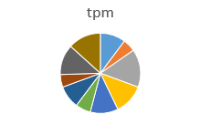
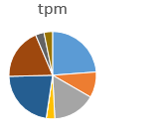
Pool synthesis
Pool cloning
Expression in yeast and pool screening
DNA-binding domain
Activation domain
D
W
W
D
Survival gene for cell growth
Nuc
Nuc
NGS read counts for each day
Log2 Growth Slope
tpm (transcripts/million) tpm
seq1 seq2 seq3 seq4 seq5 seq6 seq7 seq8 seq9 seq10
2.0 1.5 0.4 -1.4 -1.9
-2.1
2.2
2.4
-1.2 -1.3
Day 0
Day 4

Slide 2
